Slide 1
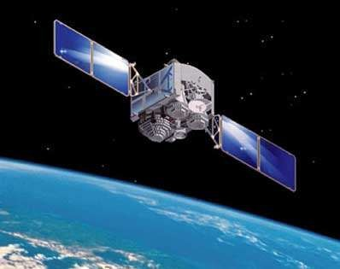



Satellite Subsystems
Irrespective of the intended application, be it a communications satellite or a
weather forecasting satellite or even a remote sensing satellite, different subsystems comprising a typical
satellite include the following:
1. Mechanical structure
2. Propulsion subsystem
3. Thermal control subsystem
4. Power supply subsystem
5. Telemetry, tracking and command (TT&C) subsystem
6. Attitude and orbit control subsystem (AOCS)
7. Payload subsystem/Communication subsystem
8. Antenna subsystem

Slide 2
Important subsystems
1. Altitude and orbit Control System (AOCS)
2.Telemetry,Tracking,Command and Monitoring (TT&M)
3. Power System
4. Communication Subsystem
5. Satellite Antennas

Slide 3
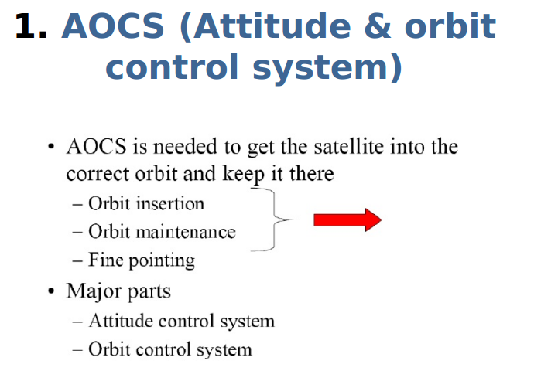

Slide 4
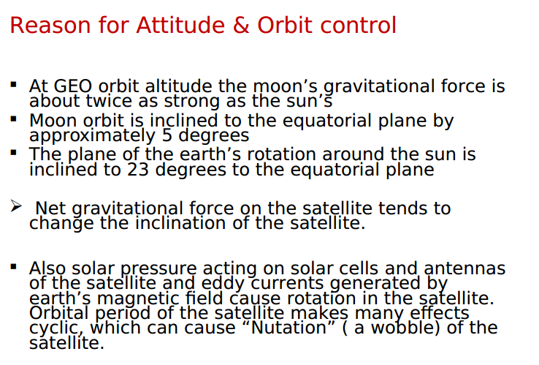

Slide 5
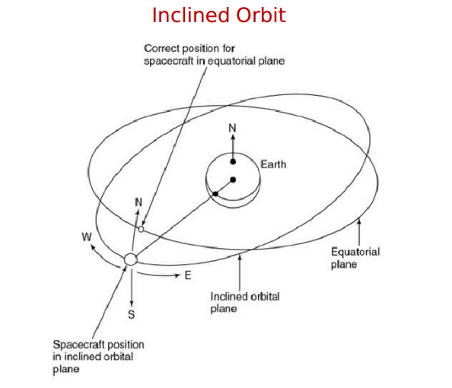

Slide 6
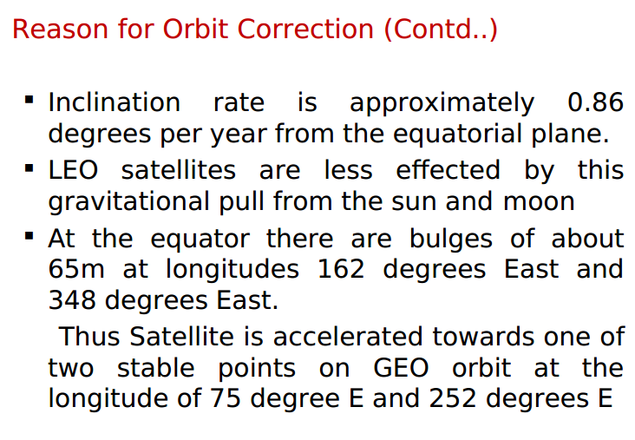

Slide 7
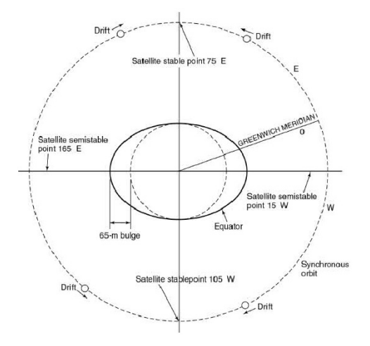

Slide 8
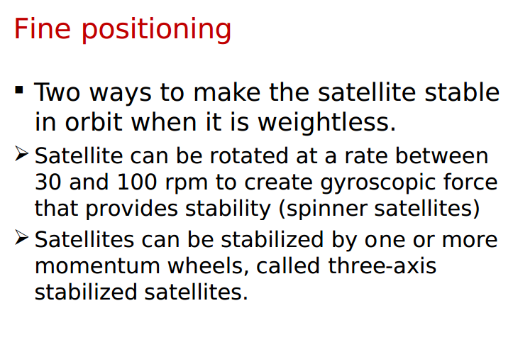

Slide 9
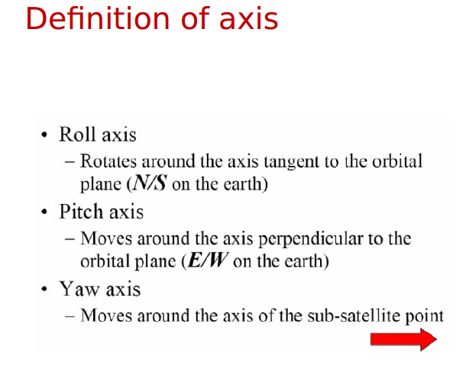
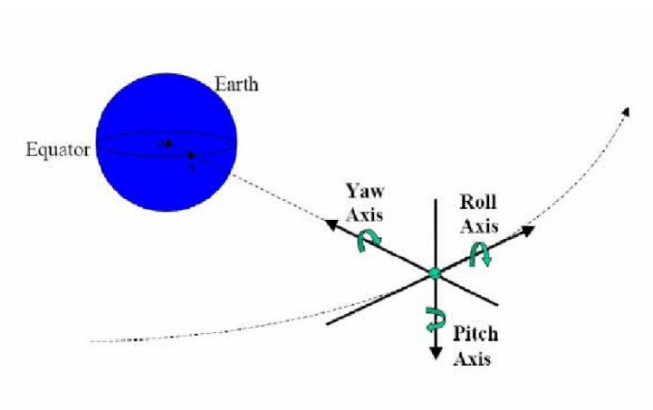

Slide 10
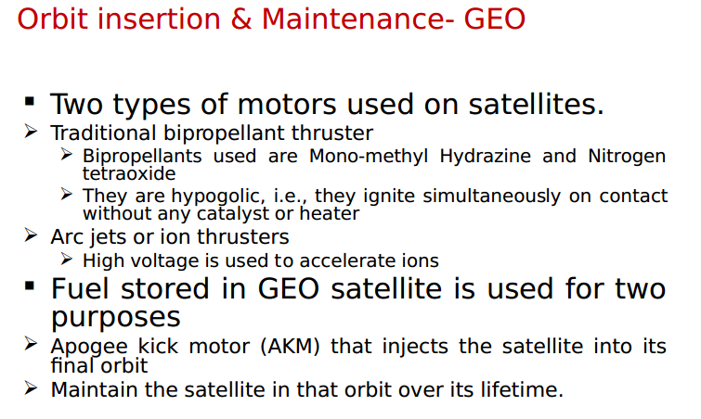

Slide 11
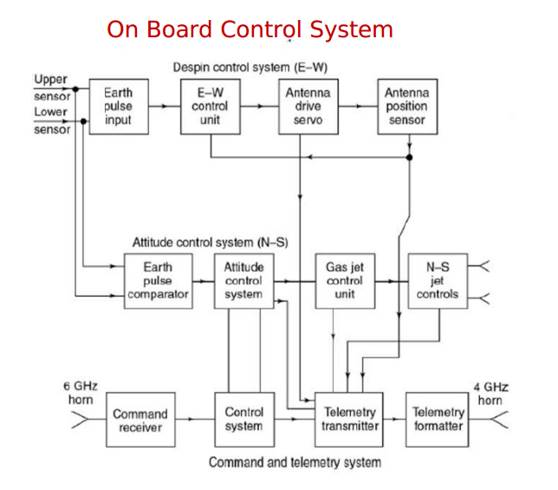

Slide 12
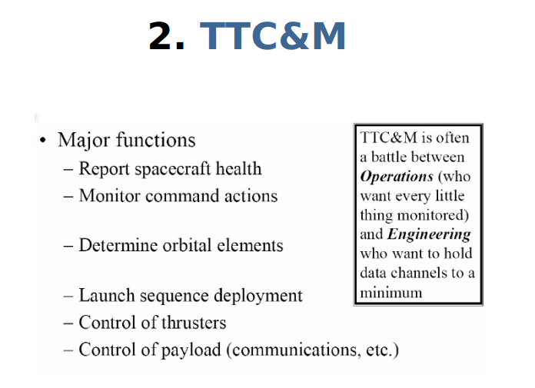

Slide 13
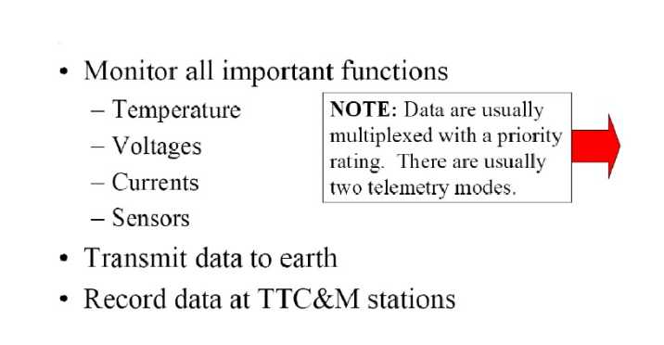

Slide 14
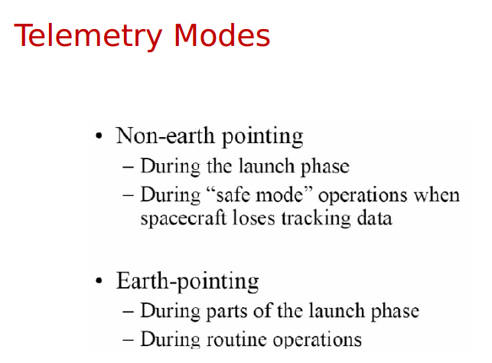

Slide 15
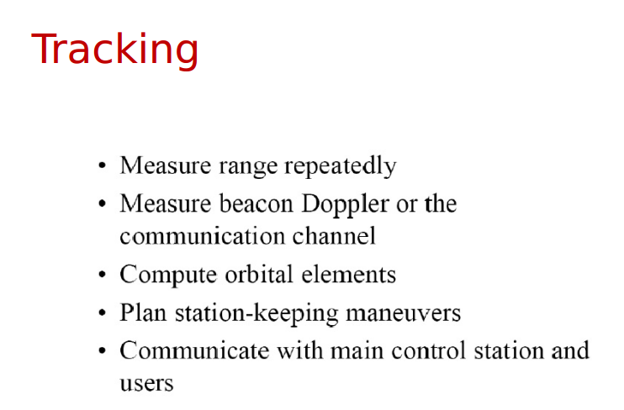

Slide 16
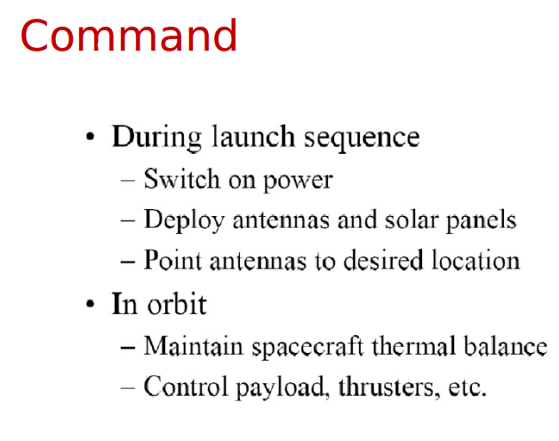

Slide 17
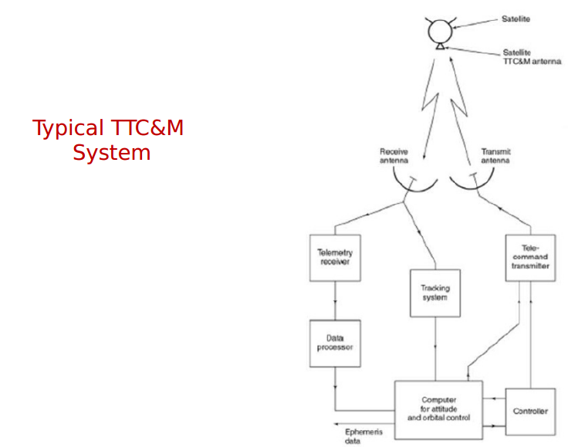

Slide 18
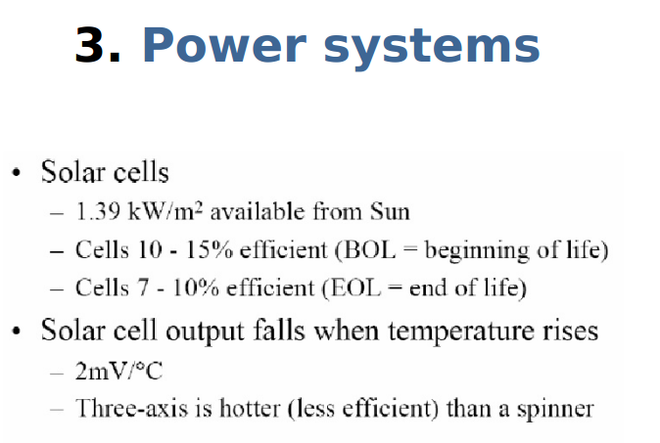

Slide 19
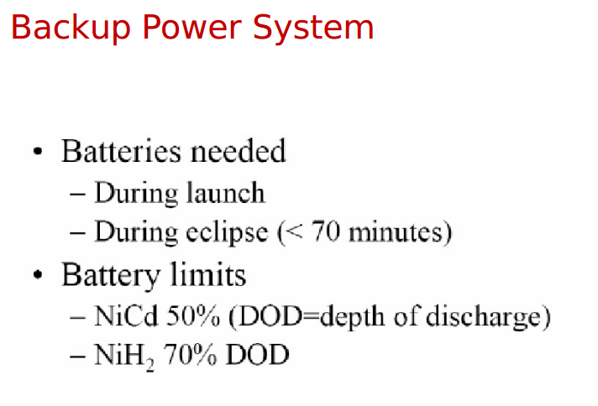

Slide 20
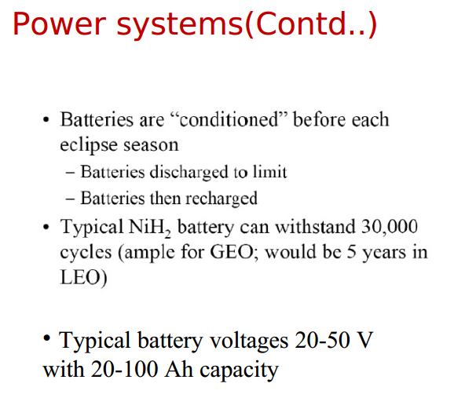

Slide 21
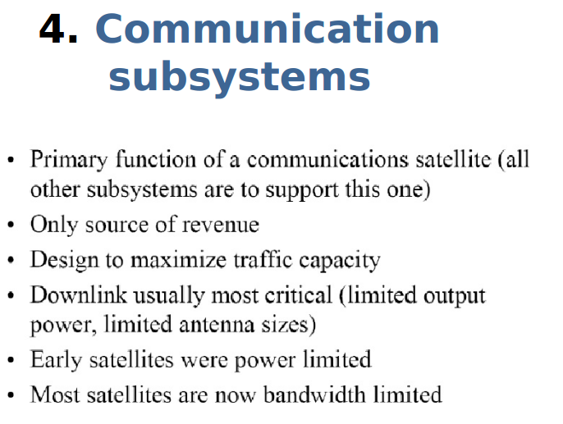

Slide 22
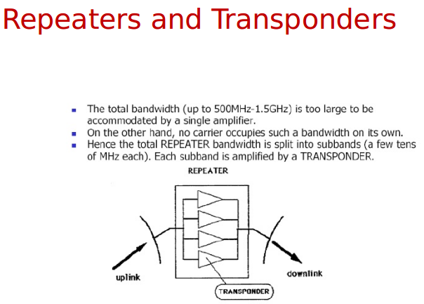

Slide 23
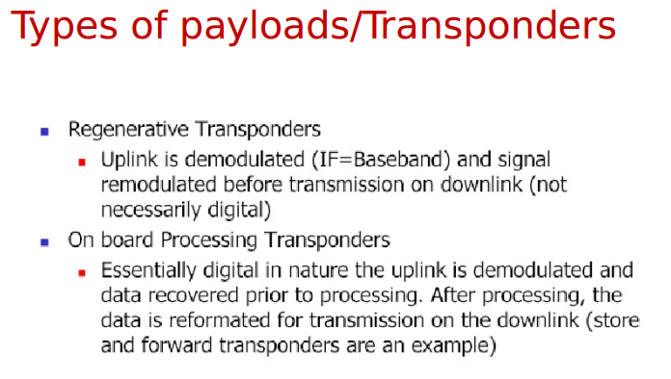

Slide 24
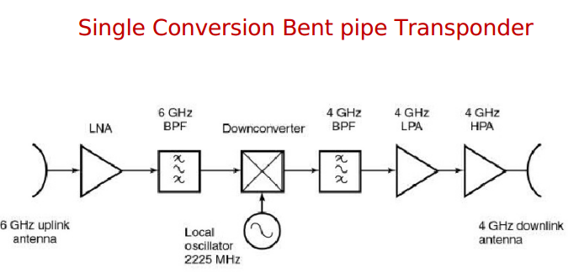
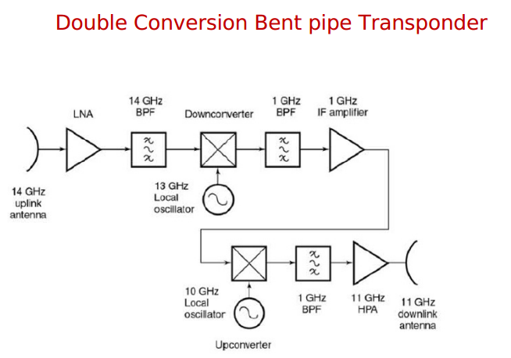

Slide 25
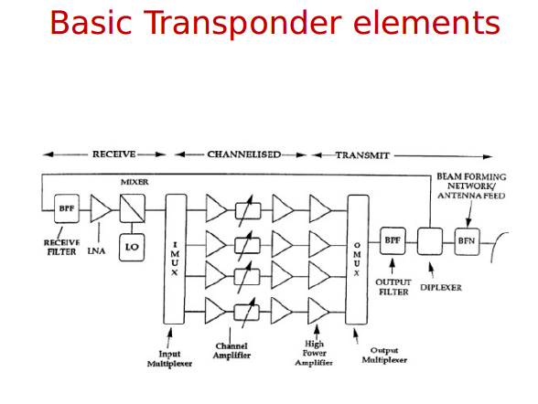

Slide 26
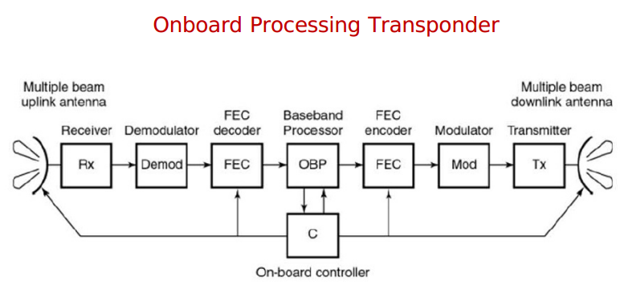

Slide 27
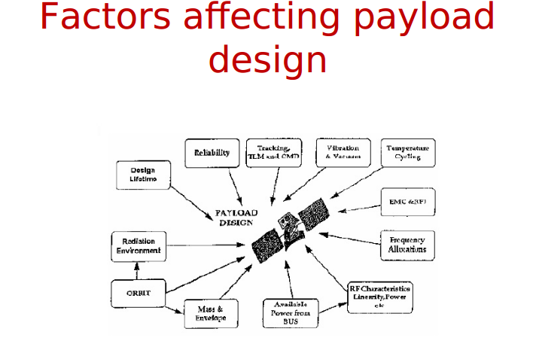

Slide 28
